Slide 2
Week 11
Uncertainty and Inference

Slide 3
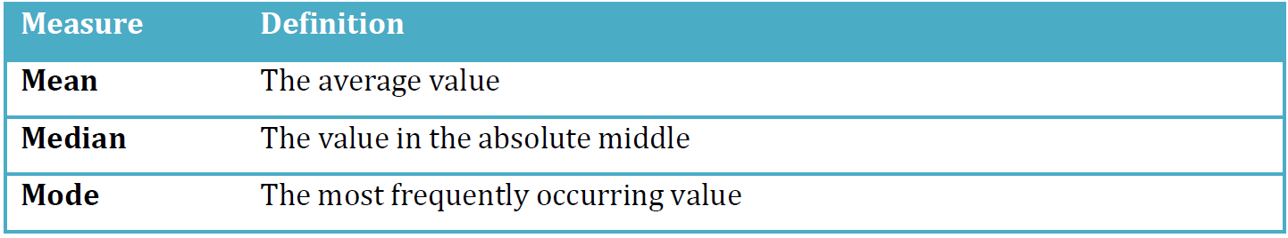
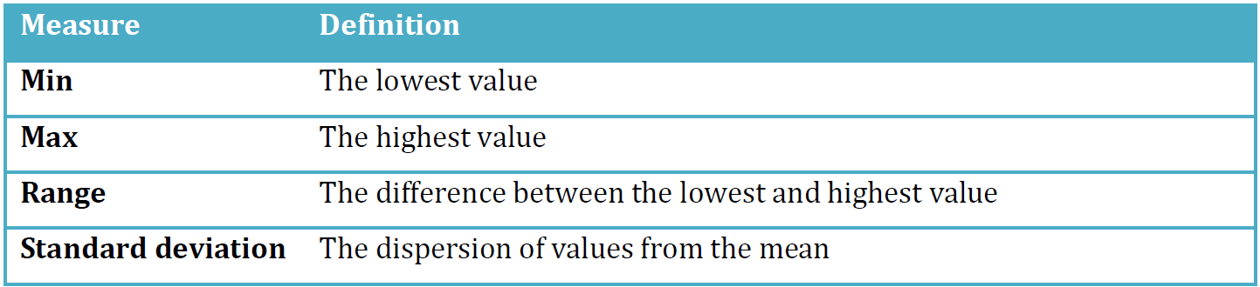
Descriptive statistics
Central tendency
Dispersion

Slide 4
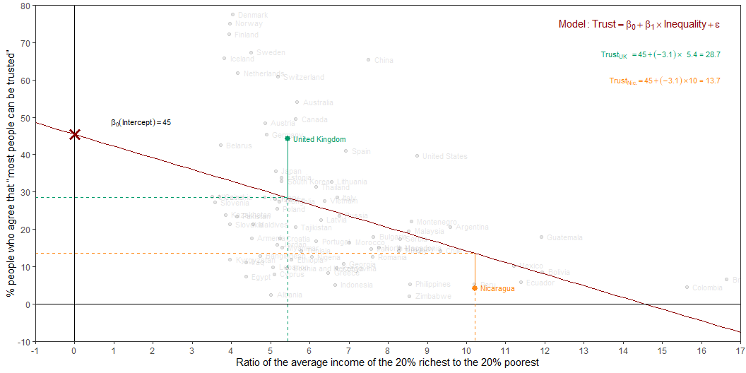
Estimation
Intercept: Social trust in countries with 0 inequality is expected to be 45.4 on average.
Slope: For each additional point increase in Inequality, the model predicts the level of social trust to be lower, on average, by 3.1 points.

Slide 5
From (sample) estimation to (population) inference
E.g.: For each additional point increase in Inequality, the model predicts the level of social trust to be lower, on average, by 3.1 points
This estimate is valid for the single sample of the countries in the model.
But what if we’re not interested in quantifying the relationship between Inequality and Trust in only this sample?
What if we want to say something about the relationship between these variables for all the countries in the world?

Slide 6
Inference
Statistical inference can be formulated as a set of operations on data that yield estimates and uncertainty statements about predictions and parameters of some underlying process or population (Gelman, Hill, and Vehtari 2020)
Statistical inference provides methods and tools for us to use the single sample we have observed to make valid statements (inferences) about the population it comes from
For our inferences to be valid, the sample should be random and representative of the population it was sampled from

Slide 7
Inference
From a mathematical standpoint, these probabilistic uncertainty statements are derived based on some assumed probability model for observed data.
The normal distribution — linear regression
The binomial distribution — logistic regression
So far, we have focused on the “point” estimates from regression models

Slide 8
Inference for regression
- confidence interval for the true slope / coefficients
- hypothesis test that the true slope / coefficient is significantly/reliably different from “0”

Slide 9
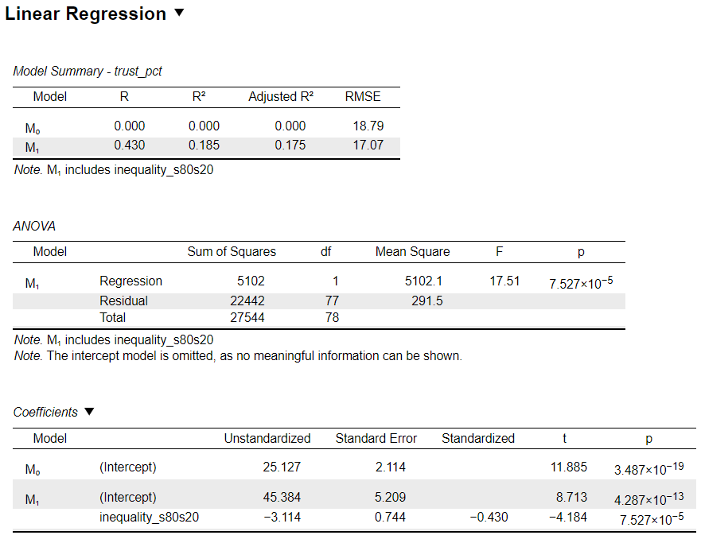
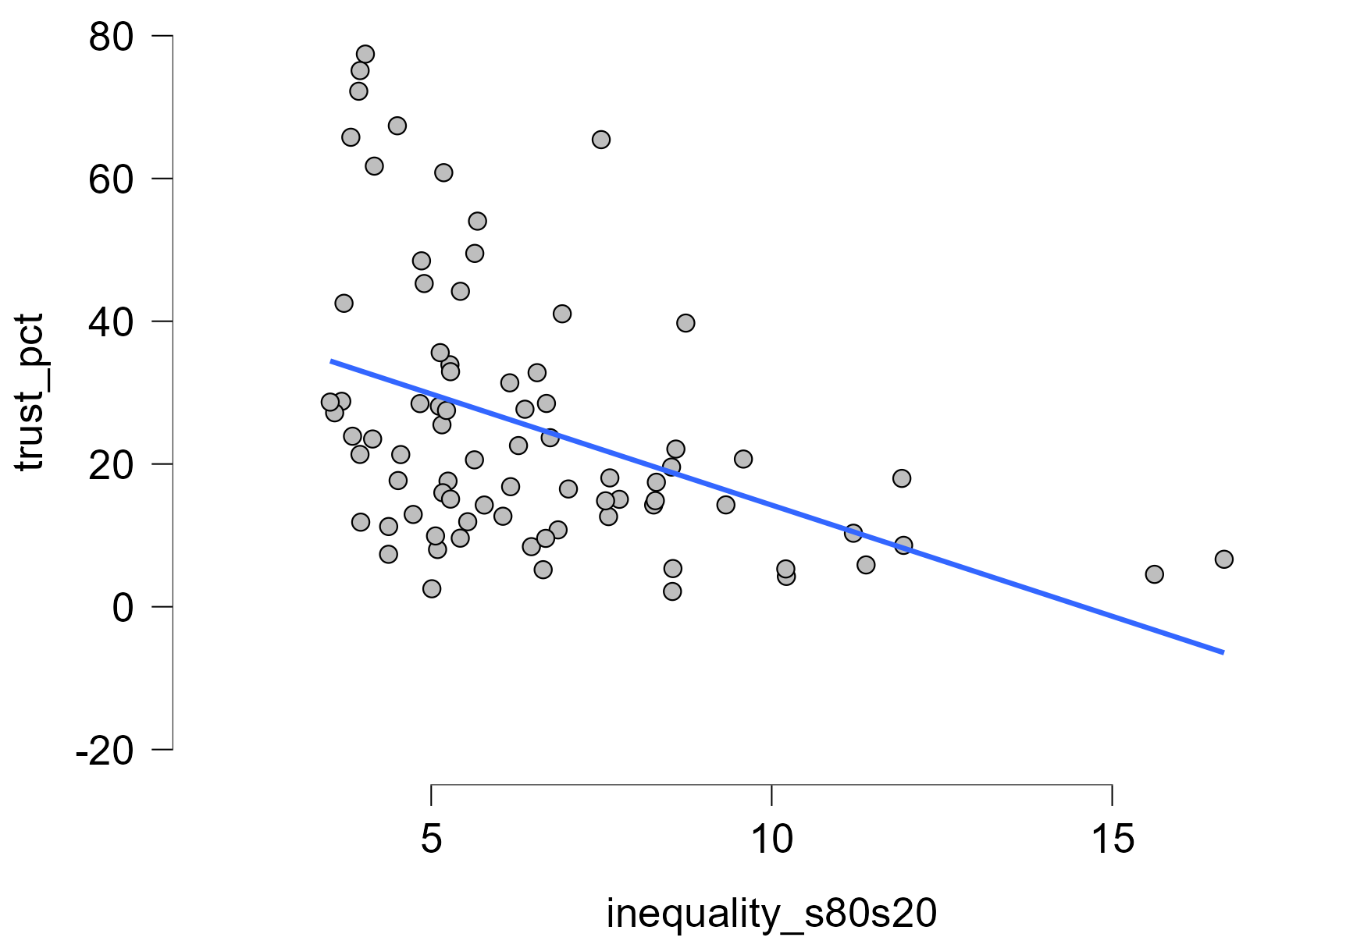
Example: Inequality → Social trust

Slide 10
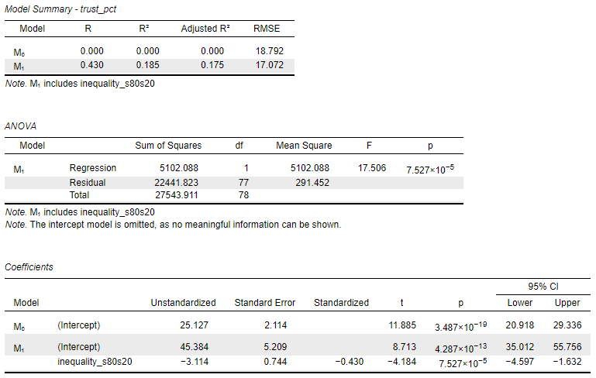
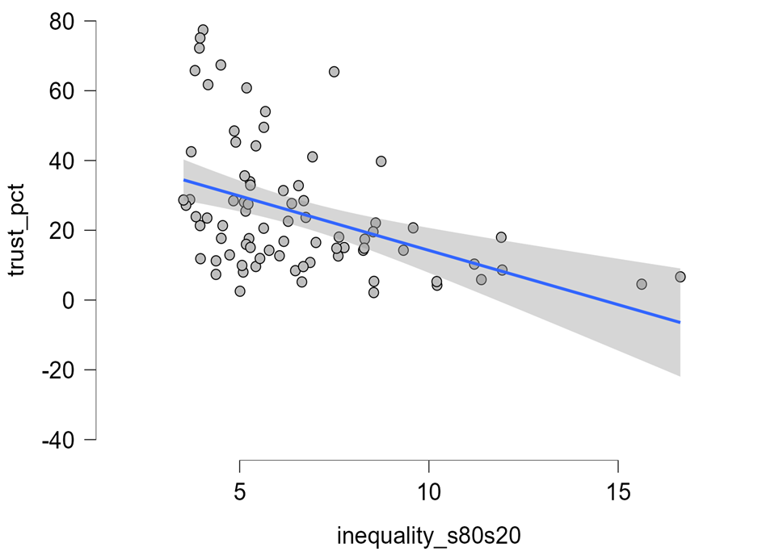
Example: Inequality → Social trust

Slide 11
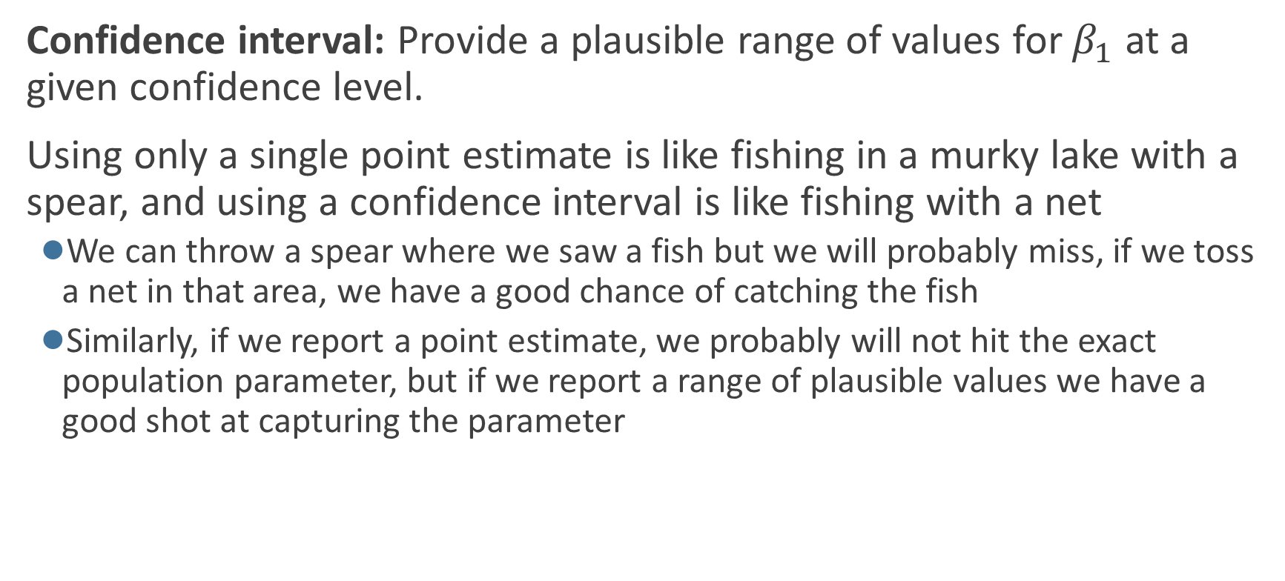
Confidence interval for the slope
Confidence interval: Provide a plausible range of values for $β_{1}$ at a given confidence level.
Using only a single point estimate is like fishing in a murky lake with a spear, and using a confidence interval is like fishing with a net
  We can throw a spear where we saw a fish but we will probably miss, if we toss a net in that area, we have a good chance of catching the fish
  Similarly, if we report a point estimate, we probably will not hit the exact population parameter, but if we report a range of plausible values we have a good shot at capturing the parameter

Slide 12
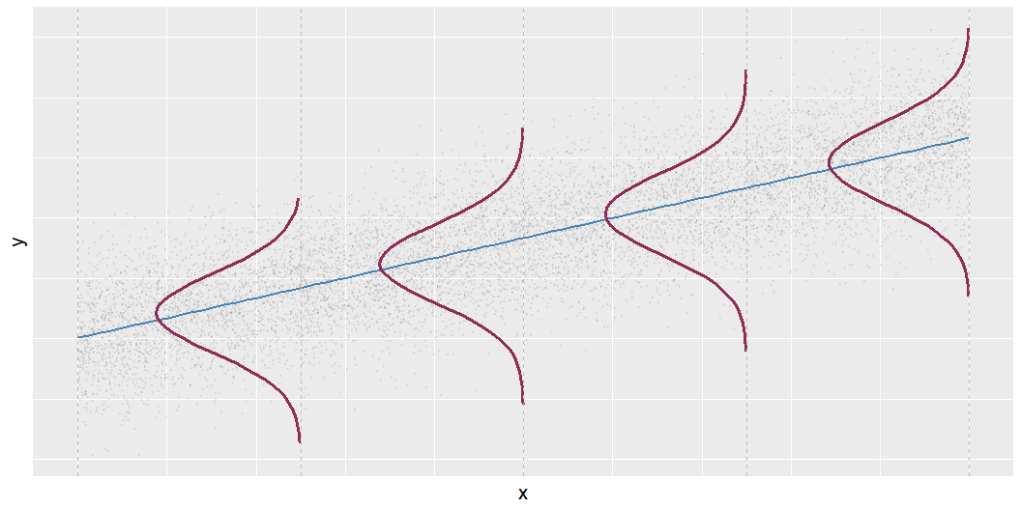
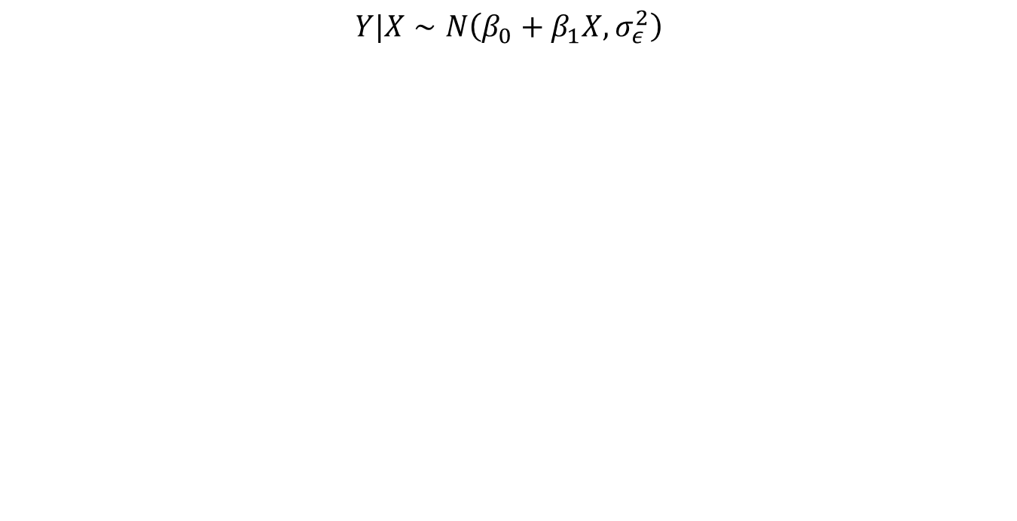

Mathematical representation, visualized
$$Y|X∼N\left(β_{0}+β_{1}X,σ_{ε}^{2}\right)$$
Mean: $β_{0}+β_{1}X$, the predicted value based on the regression model
Variance: $σ_{ε}^{2}$, constant across the range of $X$
  How do we estimate $σ_{ε}^{2}$?

Slide 13
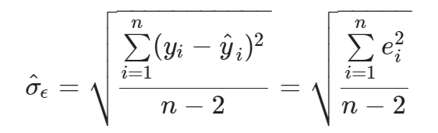
Regression standard error
Once we fit the model, we can use the residuals to estimate the regression standard error (the spread of the distribution of the response, for a given value of the predictor variable):

Slide 14
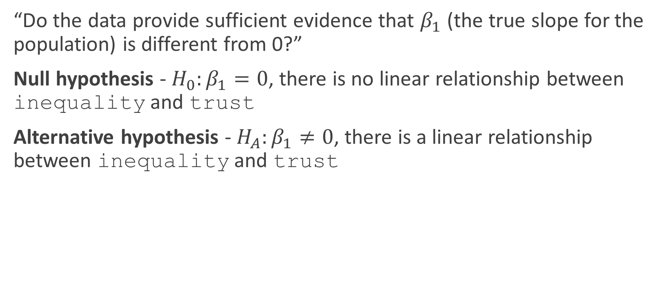
Hypothesis test for the slope
“Do the data provide sufficient evidence that $β_{1}$ (the true slope for the population) is different from 0?”
Null hypothesis - $H_{0}:β_{1}=0$, there is no linear relationship between inequality and trust
Alternative hypothesis - $H_{A}:β_{1}≠0$, there is a linear relationship between inequality and trust

Slide 15
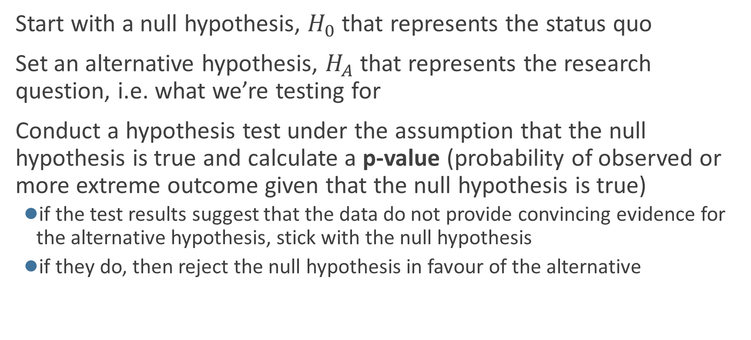
Hypothesis testing framework
Start with a null hypothesis, $H_{0}$ that represents the status quo
Set an alternative hypothesis, $H_{A}$ that represents the research question, i.e. what we’re testing for
Conduct a hypothesis test under the assumption that the null hypothesis is true and calculate a p-value (probability of observed or more extreme outcome given that the null hypothesis is true)
  if the test results suggest that the data do not provide convincing evidence for the alternative hypothesis, stick with the null hypothesis
  if they do, then reject the null hypothesis in favour of the alternative

Slide 16
Hypothesis testing framework
Statistical hypothesis testing is a thought experiment.
  Could our results just be due to random chance?
  What would the world look like if we knew the truth?
Example:
  An analyst claims that 20% of Newcastle households are in poverty.
  You take a sample of 500 households and find that 23% of the sample is under the poverty line.
  Should you conclude that the analyst is wrong?

Slide 17
Hypothesis testing framework
Null hypothesis: Some statement about the population parameters
  “Devil’s advocate” position → assumes what you seek to prove wrong.
  Usually that an observed difference is due to chance.
  Ex: poll drawn from the same population as all voters.
  Denoted 𝘏𝟢
Alternative hypothesis: The statement we hope or suspect is true instead of 𝘏𝟢
  It is the opposite of the null hypothesis.
  An observed difference is real, not just due to chance.
  Ex: polling for Trump is systematically wrong.
  Denoted 𝘏_{𝟣} or 𝘏_{𝘢}
  Probabilistic proof by contradiction: try to “disprove” the null

Slide 18
Hypothesis testing framework
p-value:
The p-value is the probability of observing data as or more extreme as our data under the “null”
  If the null is true, how often would we expect polling errors this big?
  Smaller p-value ⇝ stronger evidence against the null
  NOT the probability that the null is true!
  A p-value of 0.05 says that data this extreme would only happen in 5% of repeated samples if the null were true.
  →5% of the time we’ll reject the null when it is actually true.

Slide 19
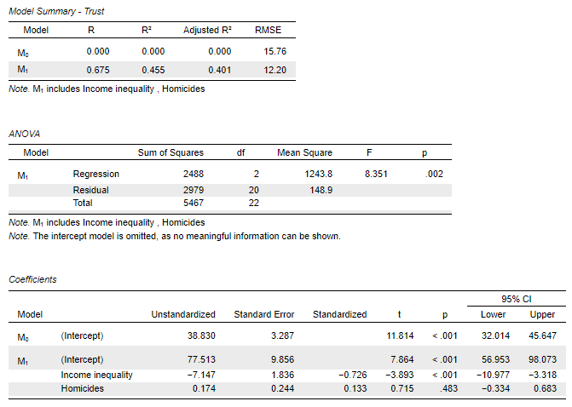
Example: Exercise 3

Slide 20
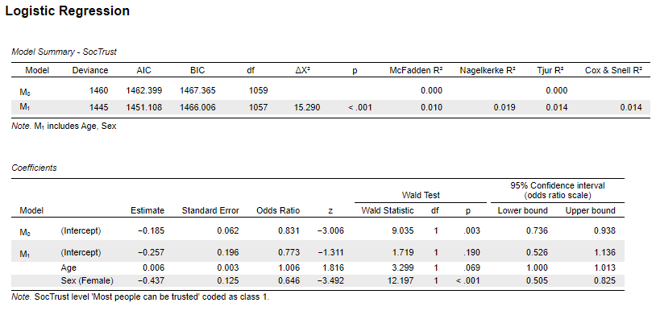
Example: Exercise 4

